Slide 1
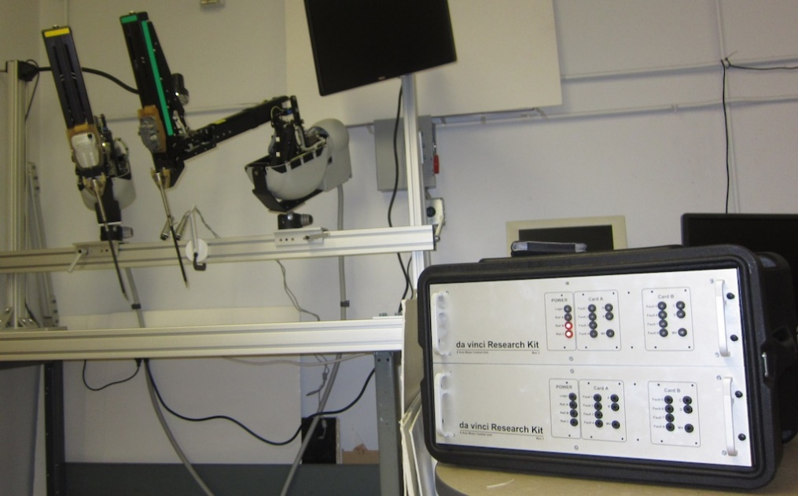

Robot Dynamics RBE-501 Spring 2016
Admittance Control of the dVRK PSM
Final Presentation
Team # 3

Slide 2
Akanksha Devkar Aman Rana Amit Trivedi Kiran Mohan Terence Carmichael
Team Members

Slide 3
Agenda
Introduction to dVRK
Problem Statement
Objectives
Project Plan
Overview of Process
Primary Purpose – Impedance Controller
Model design, Mathematical representation, Simulation of model, Analysis of result, Trade-off of model
Secondary Purpose – Haptic Feedback
Model design, Mathematical representation, Simulation of model, Analysis of result, Trade-off of model
Challenges
Deliverables proposed vs actual
Summary

Slide 4
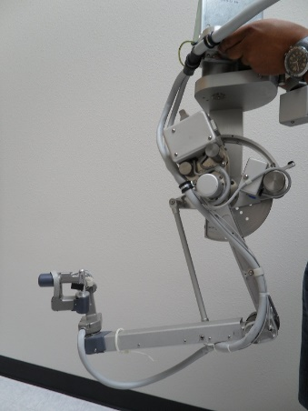
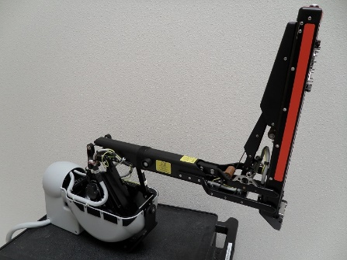
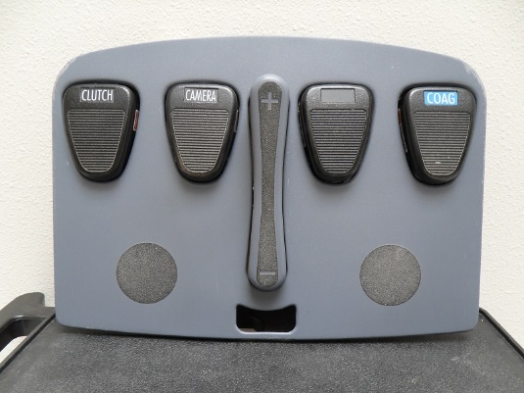
Introduction
Hardware: Da Vinci Research Kit (dVRK) Robot is a surgical robot created by Intuitive Surgical for research purposes by universities.
Components:
Surgeon’s console - consists of two Master Tool Manipulators (MTM), 8 DOF, and a foot-pedal tray.
Patient side console - consists of two Patient Side Manipulators (PSM)
DaVinci (vs Regular Laparoscopy) benefits:
Smaller incision, less pain and scaring, faster recovery, less loss of blood and reduced chances of infection.
Objective:
To model the dynamic and kinematic control of the daVinci manipulator, making use of the various principles of robot dynamics such as Jacobian matrix, D-H parameters, forward and inverse kinematics etc. to perform Adaptive Admittance control of the manipulators.
We also aim to model force feedback to the surgeon’s console manipulators, giving the surgeon additional sensory feedback thereby enhancing the current design of the robot.
PSM
MTM
Foot Pedal Tray

Slide 5
Problem Statement
A challenge for surgeons performing teleoperation with surgical manipulators is to be able to maintain the required contact force at the tool tip when interacting with the tissue.
Additionally, it is challenging for the surgeons to experience the feeling or being able to estimate the mechanical properties of tissue during surgery.

Slide 6
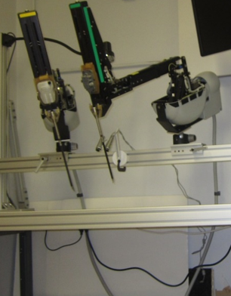
Objectives
Primary Objective
To achieve force regulation by implementing active impedance controller for the patient side manipulator (PSM) during simulation.
Secondary Objective
To develop a force feedback that would produce a simulation of the contact force at the PSM tip at the at the surgeon side manipulator (MTM).
Overachieving Objective
To apply the simulation model and computation to the physical da Vinci Research Kit in AIM lab (WPI).
Notes:
Primary Objective: To maintain the deflection of a soft body as the PSM tip pushes against the body.
Primary Measurement: Monitoring the change in the PSM tip position and measuring the output current of the joint motors and the Jacobian to compute the PSM tip contact force.
Secondary Objective: To provide the operator of the MTM to experience the force at the PSM tip.
Secondary Measurement: Monitor the contact force at the PSM tip and to measure the artificially produced force by the modeled actuator/sensor system at the MTM.

Slide 7
Project Plan
Team A and B formed
Communication platform – Slack
Source code, version control and primary documentation – git
Project planning and task assignment - Jira

Slide 8
Overview of Process
Force Regulation
Inverse kinematics as a way to control joint position for regulating tool tip position
Inverse dynamics control law for developing active impedance controller
Force Feedback
Combination of tactile and haptic feedback. At the PSM side, tactile sensors will monitor the texture of tissue and haptic feedback will help in manipulating the actions taken on MTM side.

Slide 9
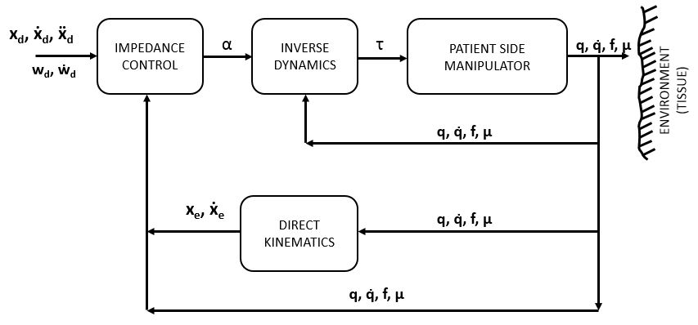
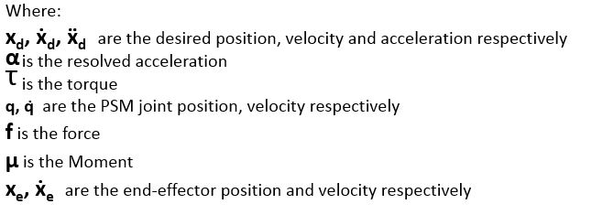
Active Impedance Controller Model

Slide 10
Active Impedance Controller Mathematical Representation
[Equation for Inverse Dynamic Control Law]
[Equation for the Active Impedance Controller]

Slide 11
Active Impedance Controller Simulation of Model
Model simulated in Matlab
[Either have embedded video or have link to YouTube]

Slide 12
Active Impedance Controller Analysis of Result
Results from varying Kd and Kp
Plots for various Kd and Kp
Statistical Analysis of simulation on model
ANOVA

Slide 13
Active Impedance Controller Trade-Off
[Being drafted … will update by Sunday night]

Slide 14
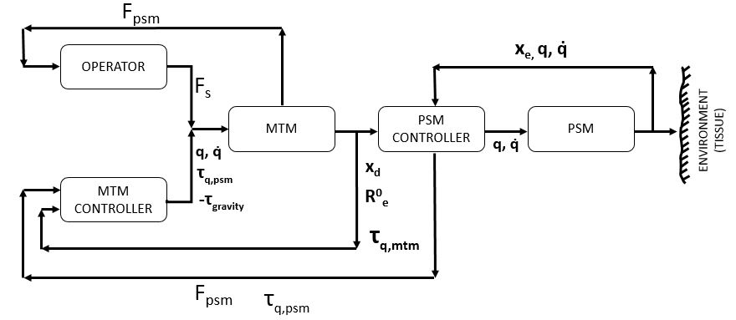
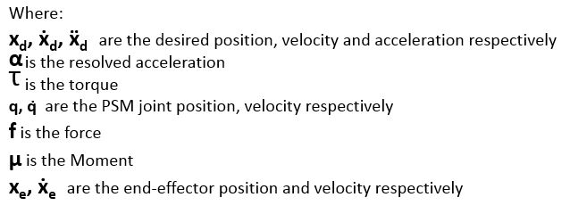
Haptic Feedback Model

Slide 15
Haptic Feedback Mathematical Representation
[Equation for haptic feedback model]
[Equation-3B? … I was not sure]

Slide 16
Haptic Feedback Simulation of Model
[Model simulated in Matlab and Simulink]
[Either have embedded video or have link to YouTube]

Slide 17
Haptic Feedback Analysis of Result
[Simulation results and plots]

Slide 18
Haptic Feedback Trade-Off

Slide 19
Overall Challenges
Infrastructure availability
Team skillset
Domain of tasks involved
Documentation on dVRK
Literature reviews
Approach for developing model
Dynamic model parameter values
Implementation and computational complexity of algorithm

Slide 20
Deliverables Proposed vs Actual
PROPOSED DELIVERABLE | STATUS
Project Plan | Completed
Requirements Document | Completed
Model for Impedance Controller | Completed
Computational Results for Impedance Controller | Completed
Simulation of Impedance Controller Model for PSM | Completed
Optimal Interaction Control | Not Completed
Model for Haptic Feedback | Completed
Computational Results for Haptic Feedback | Completed
Simulation of Haptic Feedback Model for MTM | Completed
Risk Analysis | Completed
IEEE format paper | Completed
Notes:
We plan to obtain a thorough understanding of optimal interaction control which will help us find the optimal interaction control by adjusting the gains and damping parameters.
At the end of project we plan to demonstrate the model with simulation and overachieving goal is to be able to do physical demonstration with the da Vinci kit by pulling a string held by the PSM to show use of admittance control.
Deliverables achieved – Our team was able to achieve the primary objective of developing an active impedance controller and implementing it as a simulation for the PSM. We were also able to develop a haptic feedback and implement it as a simulation.

Slide 21
Summary
Introduction to dVRK
Problem Statement and Objectives
Project Plan
Primary Objective – Active Impedance Controller
Model design, Mathematical representation, Simulation of model, Analysis of result, Trade-off of model
Secondary Objective – Haptic Feedback
Model design, Mathematical representation, Simulation of model, Analysis of result, Trade-off of model
Challenges
Deliverables proposed vs actual

Slide 22
THANK YOU

Slide 23
Outline
Team Introduction
Agenda
Problem Statement
Objectives
Deliverables achieved
Project Plan
Overview of Process
Primary Purpose – Impedance Controller
Model design
Mathematical representation
Simulation of model + video
Analysis of result
Secondary Purpose – Haptic Feedback
Model design
Mathematical representation
Simulation of model + video
Analysis of result
Trade off models
Challenges
Deliverables proposed vs actual
Summary

Slide 24
Scope and Execution
Scope
Simulate admittance control of the PSM by regulating contact force at the end effector.
Modeling the simulation of haptic feedback on the MTM based on the force at the PSM tip.
Implement the simulation in the hardware.
The project will be done within the scope of the topics covered in the course RBE-501.
The robotic system being used is Intuitive Surgical’s daVinci Research Kit (dVRK).
Feasibility
Simulating admittance control is our primary objective and needs only computers as resources and is hence, completely feasible within the given time frame.
Haptic feedback is our secondary objective and requires computing resources.
Hardware implementation requires the most resources like the physical da Vinci system and more time and hence may be the least feasible objective.
Domains covered
Admittance control and haptic feedback require sound knowledge in Robot Dynamics and Robot Control and skills like robot modeling, simulation and sensor integration.

Slide 25
Deliverables
Primary deliverable
Project plan
Requirements document
Computational results
Dynamics and kinematics
Implementation of an admittance controller for the PSM
Optimal interaction control findings
Model for monitoring force at PSM and generating real-time equivalent force at the MTM
Demonstration of the results
Final project report
Secondary deliverable
Risk analysis
Tertiary deliverable
IEEE publication of the project objectives and results.
Notes:
We plan to obtain a thorough understanding of optimal interaction control which will help us find the optimal interaction control by adjusting the gains and damping parameters.
At the end of project we plan to demonstrate the model with simulation and overachieving goal is to be able to do physical demonstration with the da Vinci kit by pulling a string held by the PSM to show use of admittance control.

Slide 26
Timelines
S No | Activity | Timeline
1 | Written proposal | Feb-18
2 | Project Plan | Feb-26
3 | Requirements document | Feb-26
4 | Evaluate Inverse Kinematics | Mar-04
5 | Evaluate Forward Kinematics | Mar-11
6 | Simulation model for monitoring force at PSM | Mar-25
7 | Risk Analysis | Apr-01
8 | Complete Simulation | Apr-07
9 | Modifications and Improvements | Apr-19
10 | Final project presentation | Apr-26

Slide 27
Challenges
Challenges
Physical and Virtual System implementation
Multiple users working on one product.
Level of Effectiveness
Team Aspect:
Deliverables
Priorities
Logistics
Solutions
Implementing a comprehensive verification and validation plan.
Utilizing revision control software throughout the course of development.
Thorough Research & Analysis of past and present surgical technology.
Consistent communication and strategic planning of our tasks and activities.

Slide 28
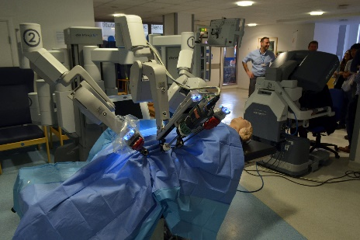
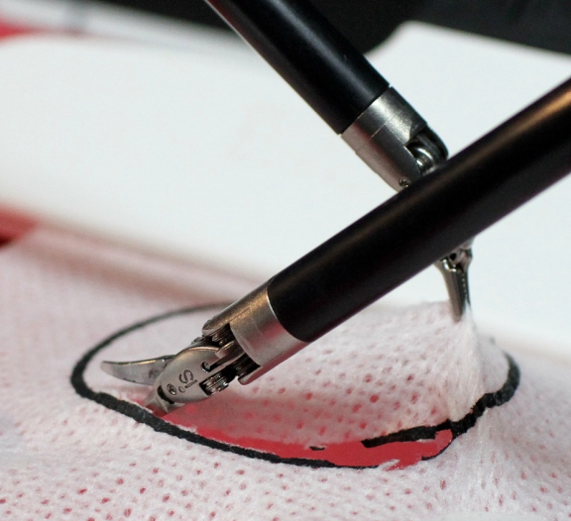
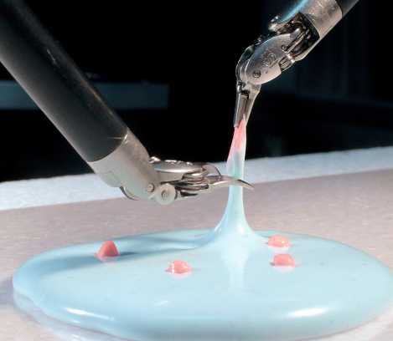
Audience
Primary audience
Students and researchers working in the field of robotics, mechanical and instrumentation engineering
Secondary audience
Faculty in the field of robotics engineering
Tertiary audience
Medical Industry: For surgical robot manipulators
Electronic Industry: For handling thin wafers
Food Industry: Handling fragile food items
Automation Industry: Handling ceramic catalytic converters
Casting Industry: Handling wax patterns in investment casting
Space Exploration: Handling fragile evidences in outer space

